Slide 1

Airline Safety
Shilpa Kolekar DSC 640 11/20/2021

Slide 2
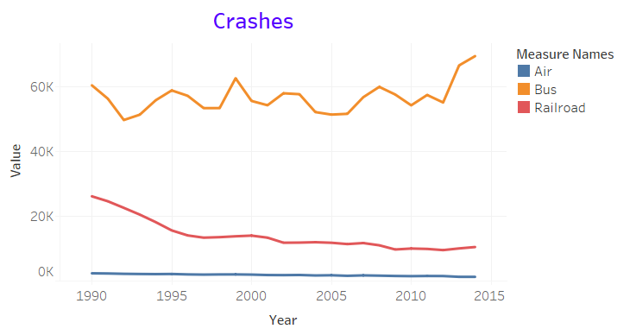
Crash Comparison
Bus crashes were highest, and they continued to increase
Railroad crashes were next, and they decreased over time
Air crashes were lowest, and significantly low compared to bus and rail crashes

Slide 3
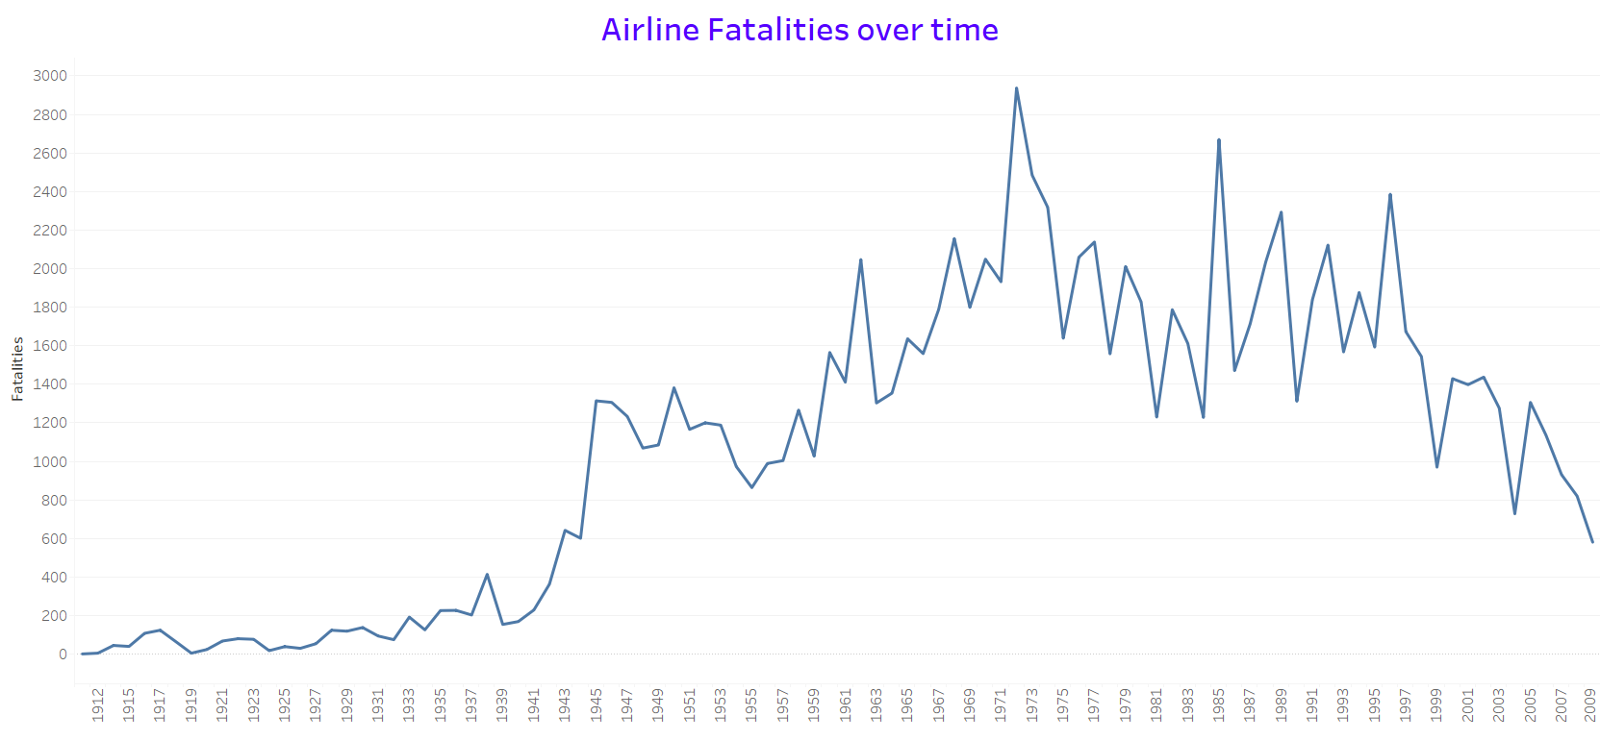
Airline Fatalities over time
Airline fatalities showed an increasing trend through 1972
The fatalities started decreasing since then

Slide 4
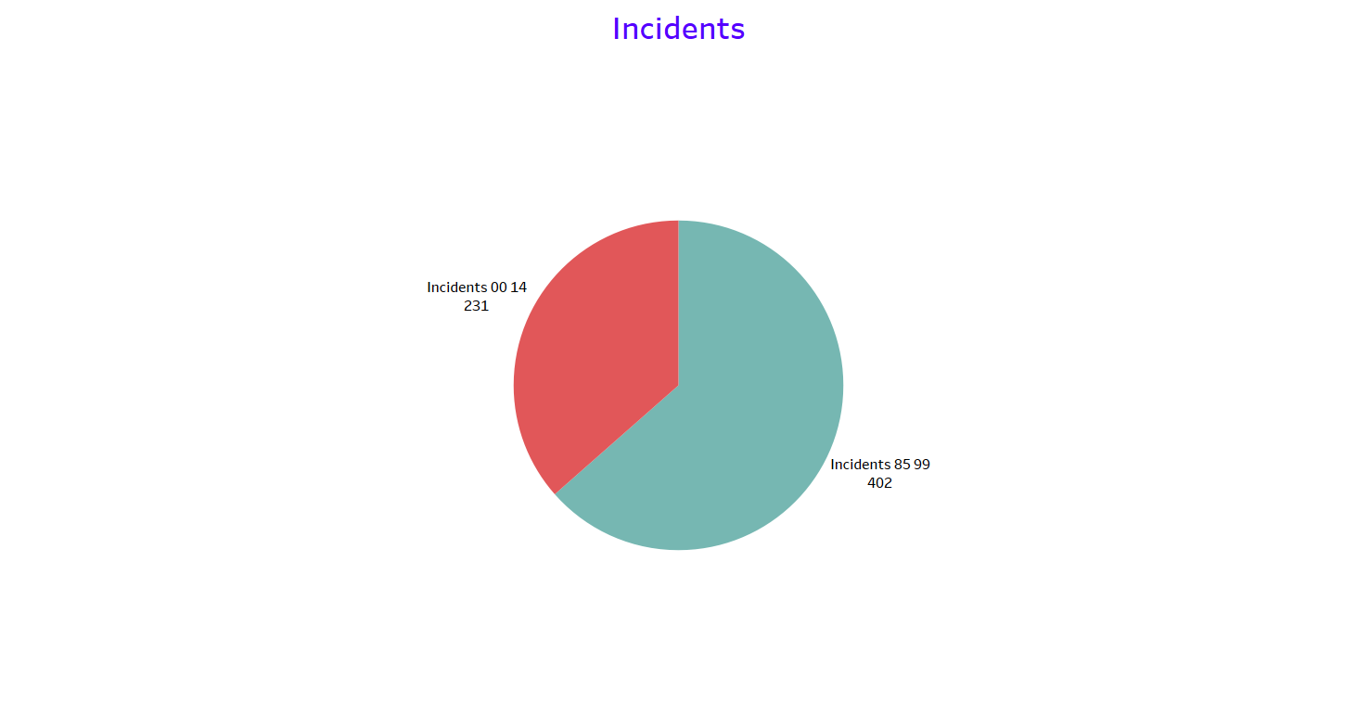
Airline Incidents
Incidents in years 85-99 were 402
Incidents in years 00-14 were 231
Incidents drastically dropped over the time

Slide 5
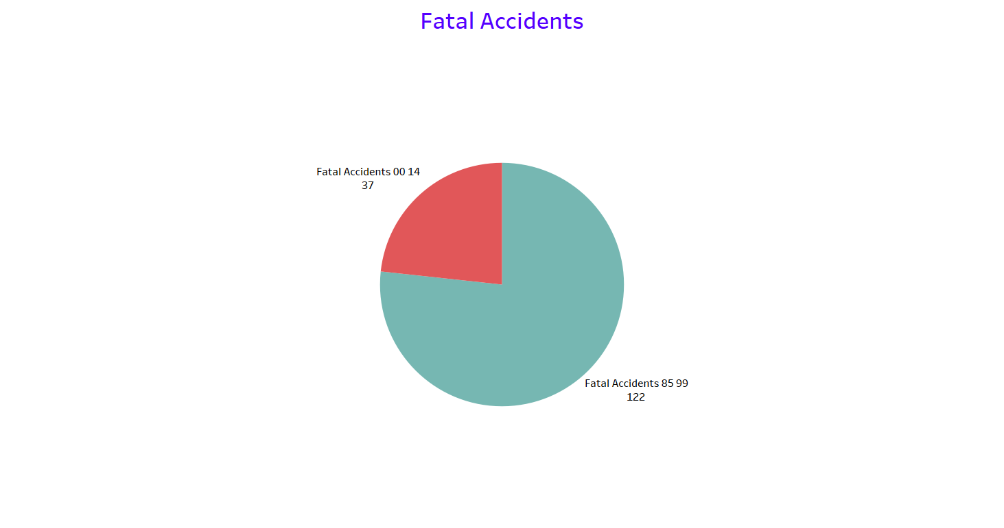
Airline Fatal Accidents
Fatal accidents in years 85-99 were 122
Fatal accidents in years 00-14 were 37
Fatal accidents drastically dropped over time

Slide 6
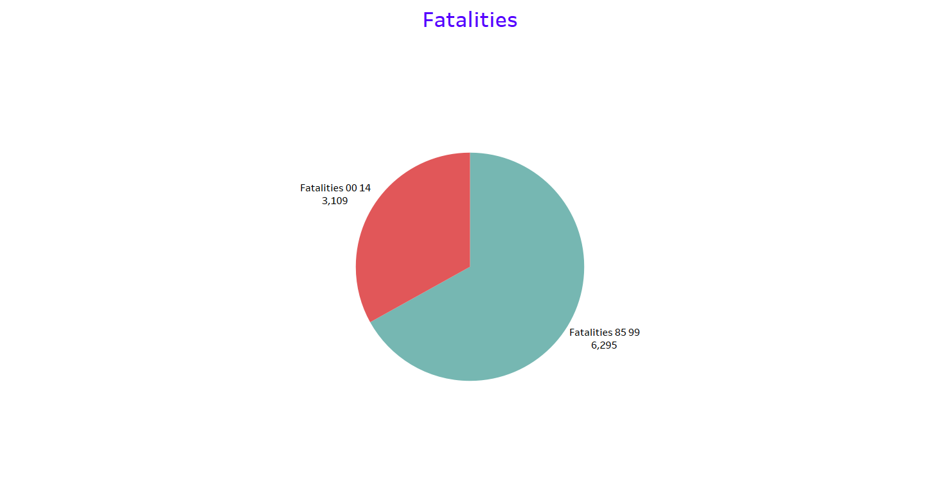
Airline Fatalities
Fatalities in years 85-99 were 6295
Fatalities in years 00-14 were 3109
Fatalities drastically dropped over time

Slide 7
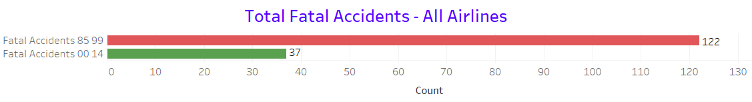
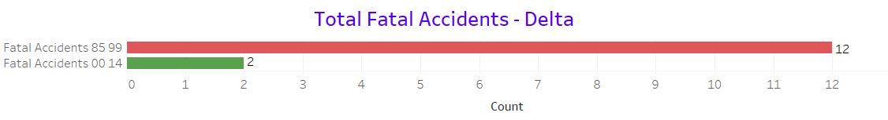
Delta Airlines – Fatal Accidents
Over time, the fatal accidents of Delta Airlines reduced significantly compared to all airlines

Slide 8
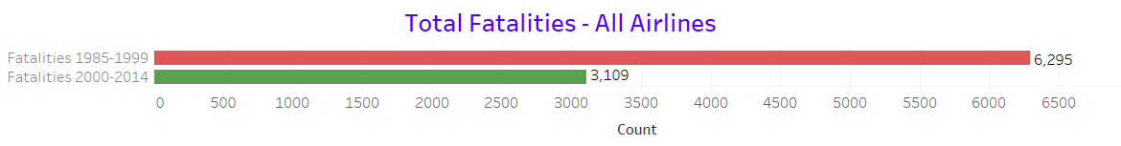
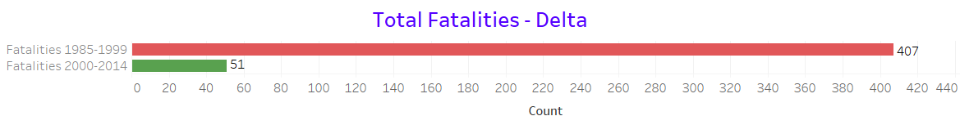
Delta Airlines – Fatalities
Over time, the fatalities of Delta Airlines reduced significantly compared to all airlines

Slide 9
Conclusion
Airline crashes were significantly less compared to bus crashes and railroad crashes over time
Airline fatalities had increased through 1972, but started decreasing significantly since then due to safety measures
Total Airlines incidents, fatal accidents, and fatalities dropped significantly over time
Delta Airlines showed similar trend where fatal accidents and fatalities reduced drastically compared to all airlines

Slide 10
Thank You!

